Slide 1

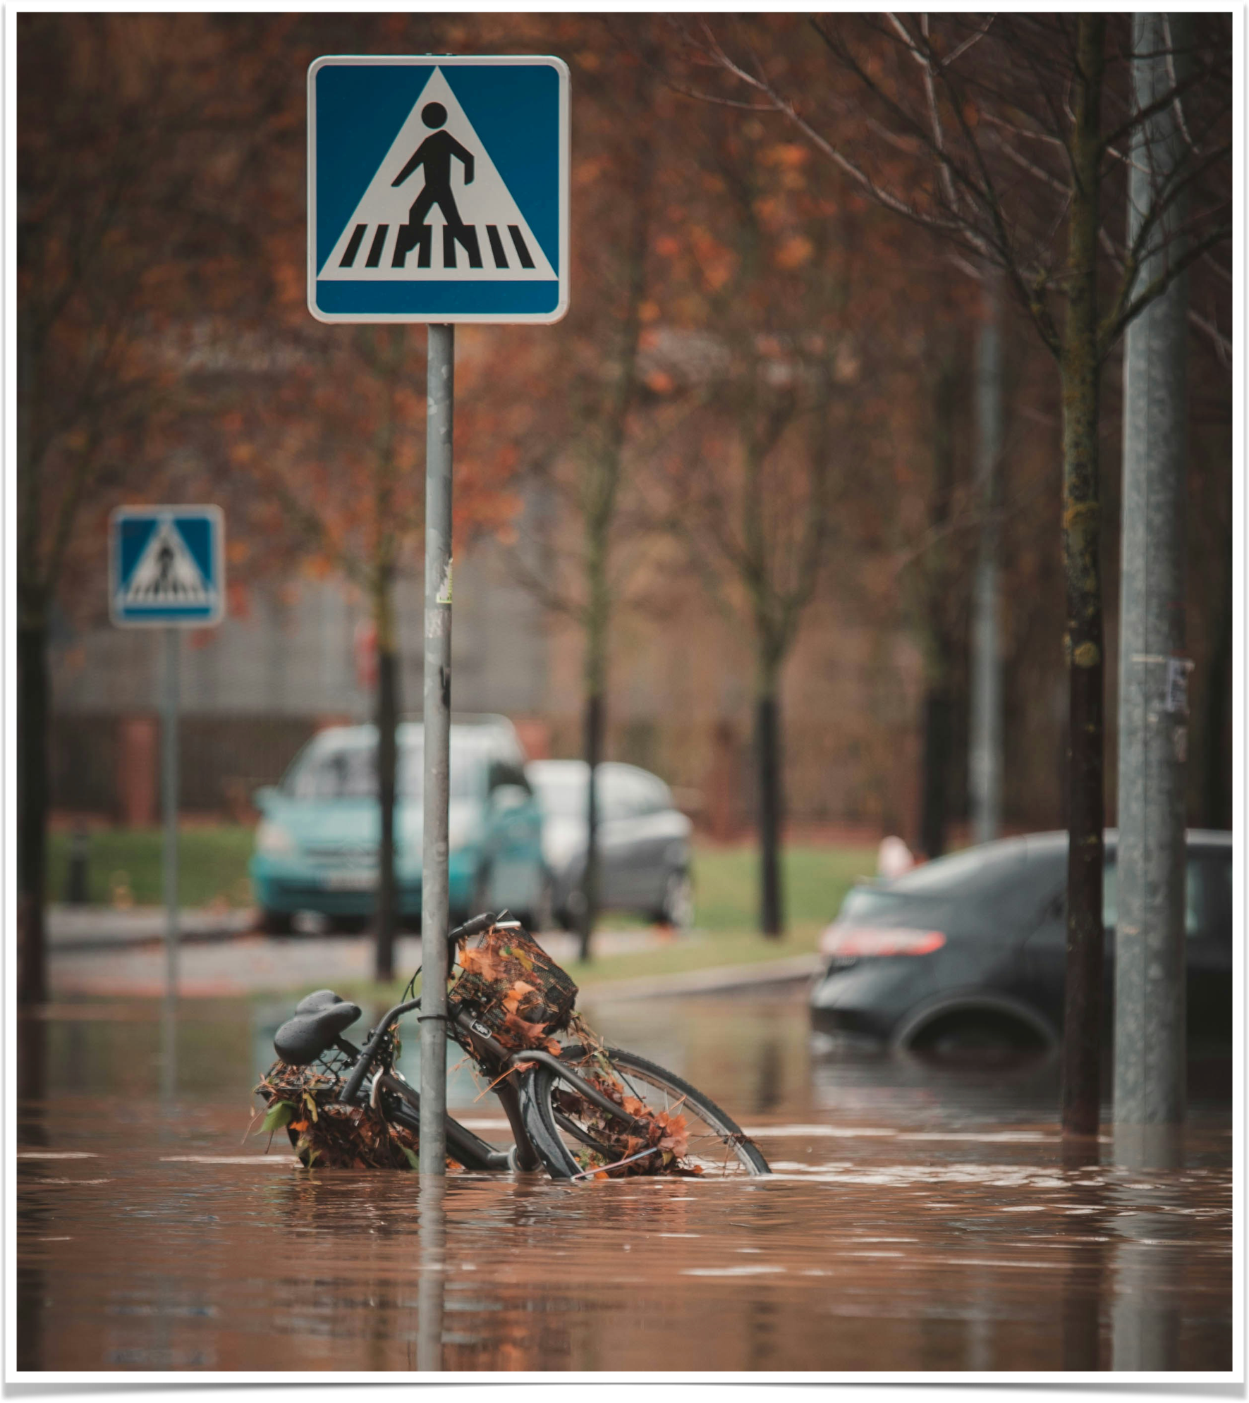
Mini Project - Satellite image overlay with floodwater.
Flood Mapping
22BDS008 Ashutosh Wani 22BDS021 Aman Gaikwad
22BDS062 Varang Pratap Singh 22BDS064 Viraj Surana

Slide 2
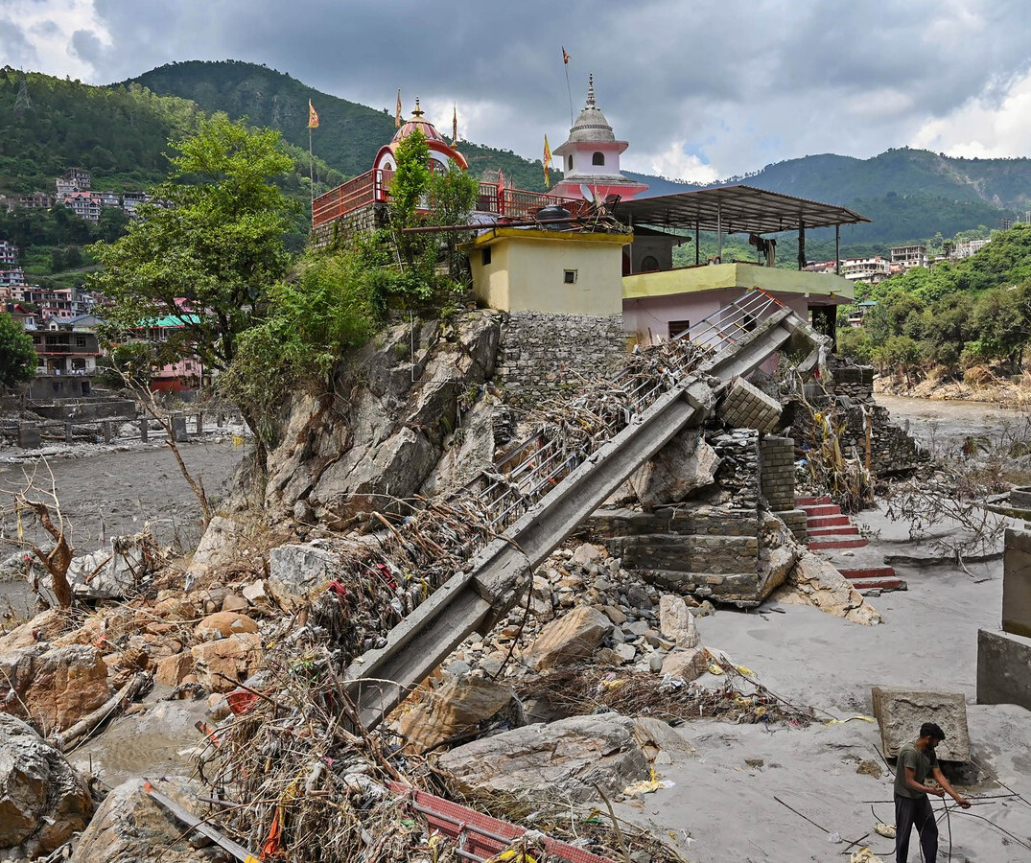
Devastating Impact of Floods
❖
High Mortality: Floods cause tens of thousands of deaths annually, with some disasters (e.g., 1931 China floods) claiming millions of lives.
❖
Mass Displacement: Floods displace millions, as seen in the 2022 Pakistan floods, which left 33 million homeless and vulnerable to disease and poverty.
Economic Loss: Floods result in billions in damages, like the 2011 Thailand floods, which caused $45 billion in losses, devastating economies and infrastructure.
❖

Slide 3

Why is Flood Detection Necessary?
❖
Increasing Frequency of Floods: Climate change and urbanization contribute to more frequent and severe floods.
❖
Economic & Human Loss: Floods cause billions in damages and loss of lives annually.
❖
Early Warning & Response: Timely detection helps in disaster preparedness and reducing casualties.
❖
Monitoring Remote Areas: Traditional methods fail in inaccessible regions, making satellite-based solutions crucial.

Slide 4
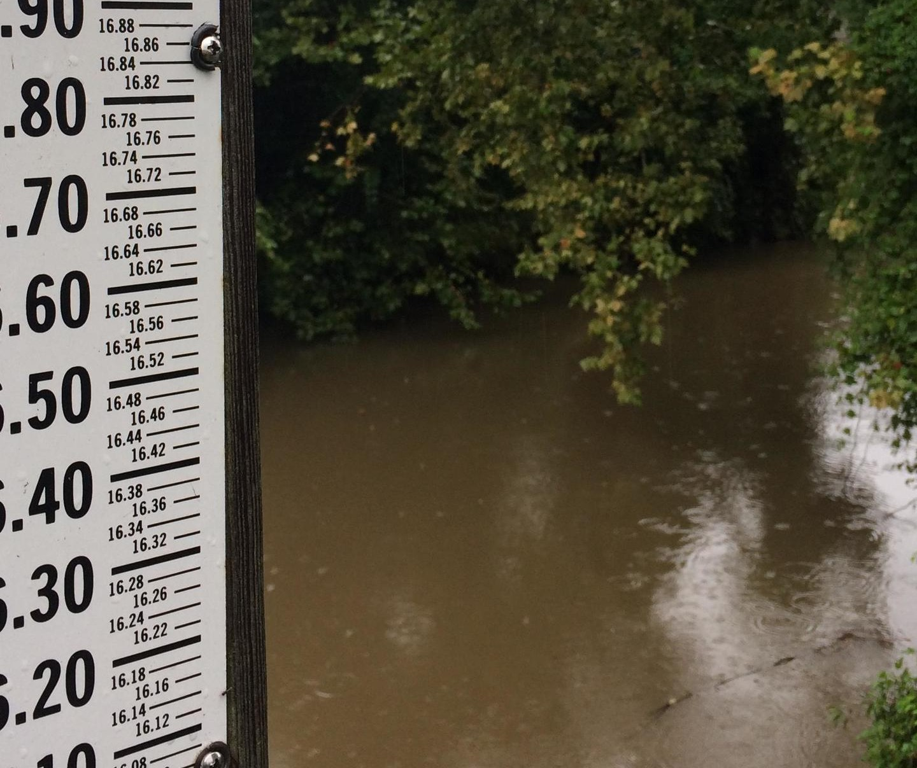
Current Techniques for Flood Detection
❖
Optical Remote Sensing (Landsat, MODIS) captures visible/infrared images but fails in clouds/nighttime.
❖
SAR Imaging works in all weather and detects water using backscatter differences.
❖
Ground-Based Monitoring : River gauges and sensors measure real-time water levels but cover only limited areas.
❖
AI & Machine Learning Models: Combine satellite data with AI to improve flood prediction and mapping accuracy.

Slide 5
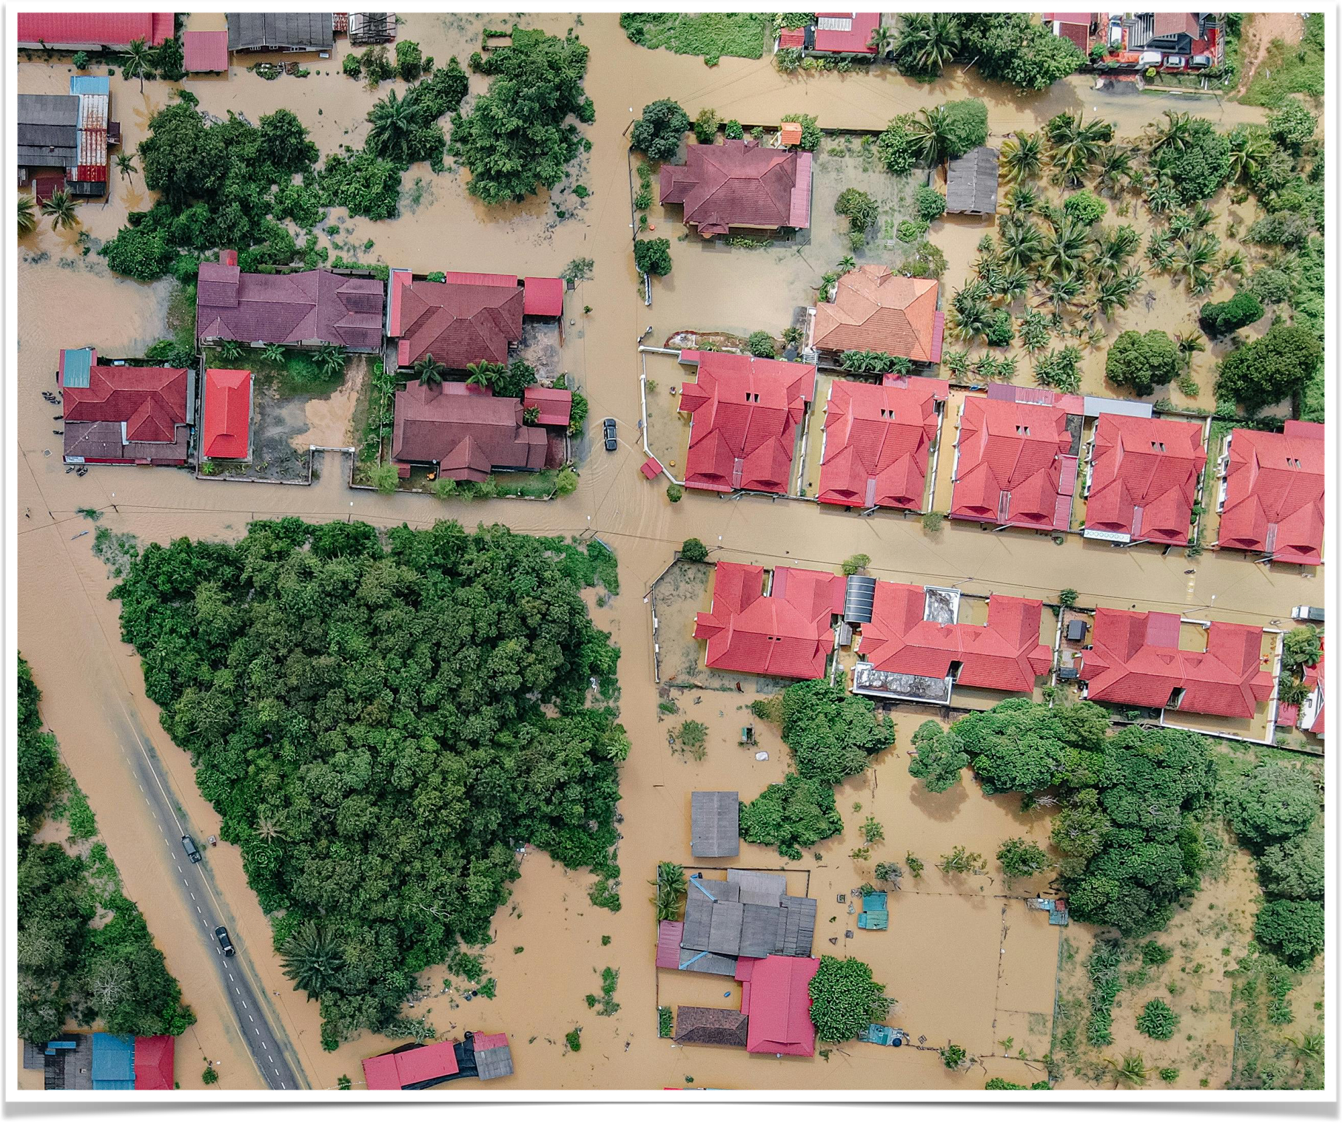
Project Overview
❖
Optical images have limited applications due to cloud cover during heavy rainfall, its effectiveness in flood detection is limited.
❖
Synthetic Aperture Radar imagery offers a more reliable and robust solution for identifying flooded areas, since it is not affected by weather conditions.
❖
Flooded regions can be mapped by comparing images taken before and after a flood event.

Slide 6
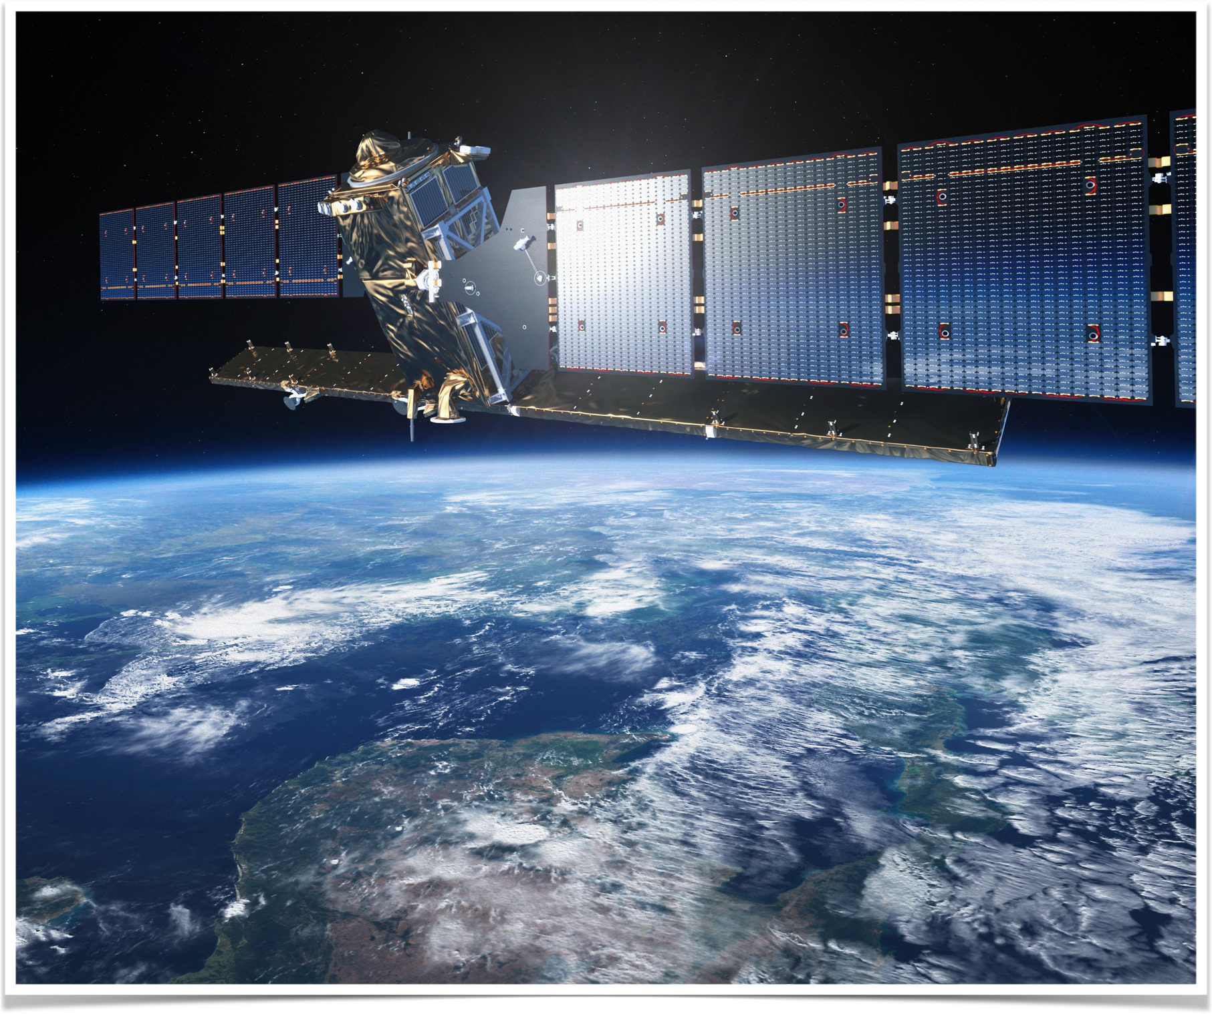
Sentinel-1 SAR GRD
❖
Mission consists of two satellites, Sentinel-1A and Sentinel-1B.
❖
Equipped with a C-band Synthetic Aperture Radar (SAR) sensor allow the satellites to operate in both day and night.
❖
The SAR sensor enables all-weather operation, as it can penetrate clouds.
Over land and coastal areas, images are captured using the Interferometric Wide mode.
Most regions worldwide are imaged with VV and VH polarizations.
❖
❖

Slide 7
Polarization and Operational Modes
❖
Sentinel-1 can be configured to receive specific polarizations simultaneously, transmitting signals in either horizontal (H) or vertical (V) polarization and receiving in both H and V.
❖
Captured images are available in different polarization bands: HH, HV, VV, and VH.
The satellite operates in three different modes namely:
❖
Interferometric Wide Swath (IW)
Extra Wide Swath (EW) Strip-Map (SM)
❖
❖

Slide 8
Sentinel Level-1 Products
❖
Single Look Complex (SLC):
Maintains slant geometry, meaning some pixels are closer to the satellite than others.
Retains phase information, making it useful for interferometry. Ground Range Detected (GRD):
❖
Projected to the ground, ensuring uniform pixel resolution.
Contains only pixel intensity, without phase information. Reduced noise, making it ideal for land cover mapping.
❖
❖

Slide 9



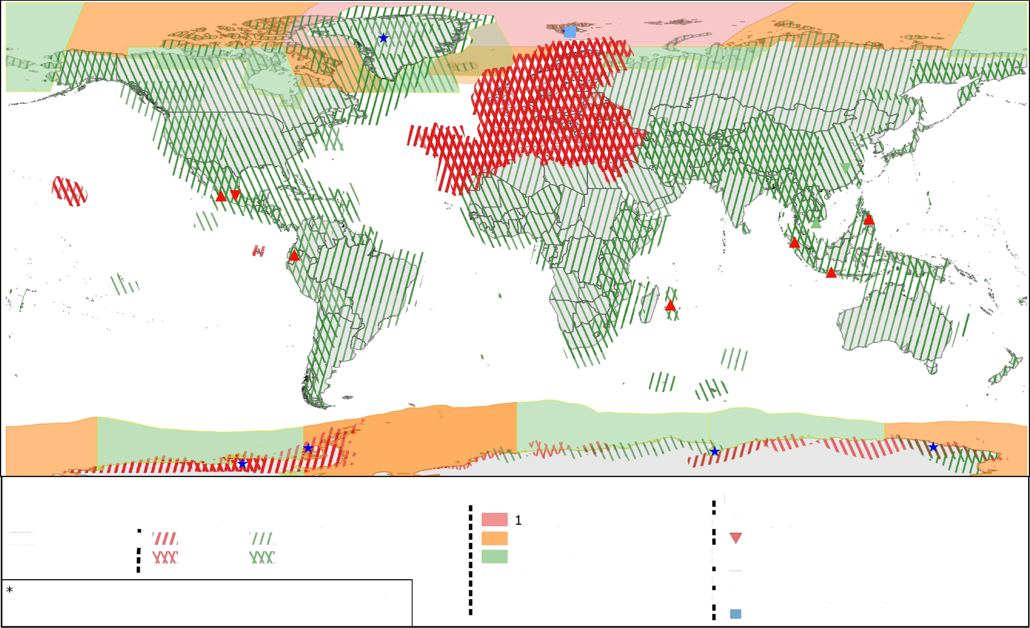
Sentinel- Constellation Observation Scenario: Revisit Coverage Frequency
sentin I-
validity start: 05/2019
PASS | t | REVISIT | FREQUENCY * | COVERAGE | FREQUENCY | ”^ | REFERENCE DATA SITES (mdrepeat)
ASCENDING |  | 6 days | XS1' 12 days | days |  | i | A Highly active volcanism
/) DESCENDING | i |  |  | 1-3 days |  |  | Fast subsidence
 |  |  |  | 2-4 days |  | m i | A Short growth cycle, intensive agriculture T Fast changing wetlands
coverage ensured from same, repetitive relative orbits
** coverage not considering repetitiveness of relative orbits
i W Fast moving outlet glaciers
Permafrost & glaciers

Slide 10




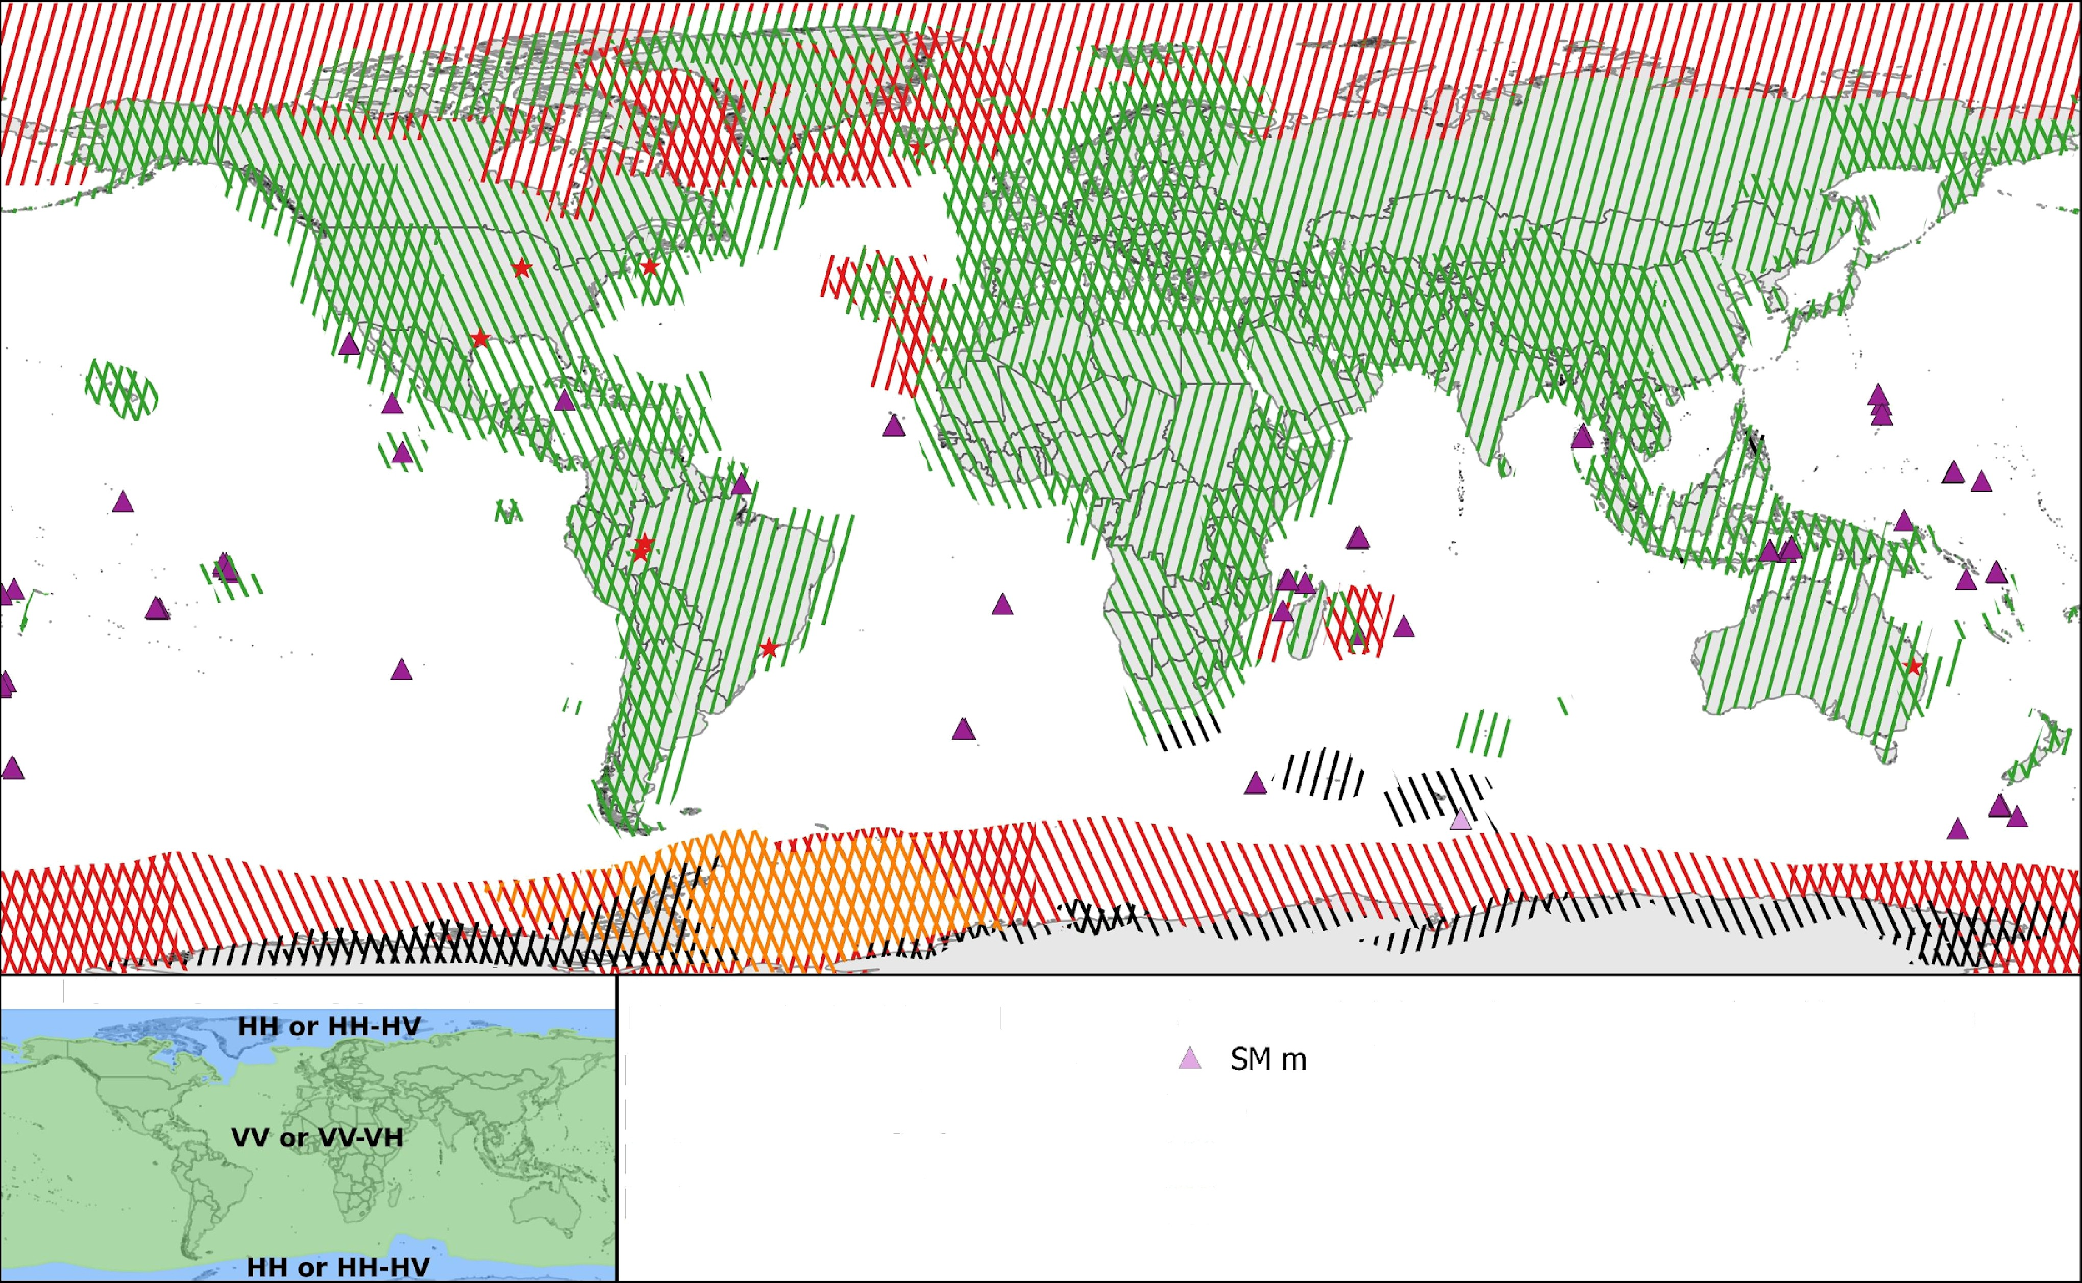
Sentinel-
senti -
validity start: 05/2019
Constellation Observation Scenario: Polarisation - Observation Geometry
POLARISATION SCHEMA
MODE / POLARISATION
IW mode / dual polarisation IW mode / single polarïsation EW mode / dual polarisation EW mode / single polarisation
A SM mode / dual-polarisation
ode / single-polarisation
* Calibration Site
(locally different modes or
polarisations possible)
PASS
@'g\' ASCENDING
(ff) DESCENDING

Slide 11
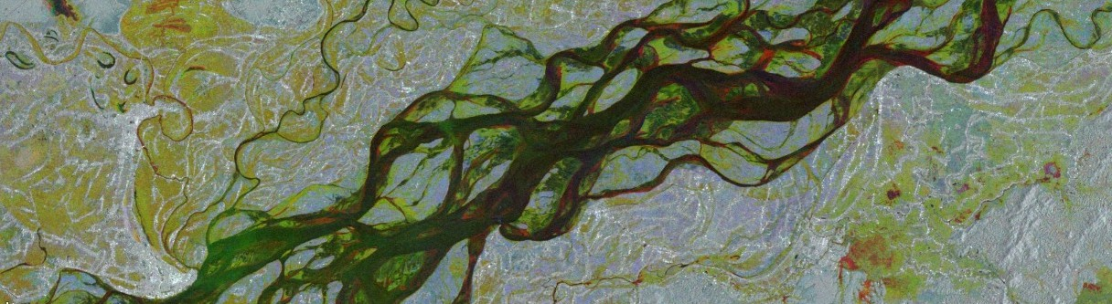
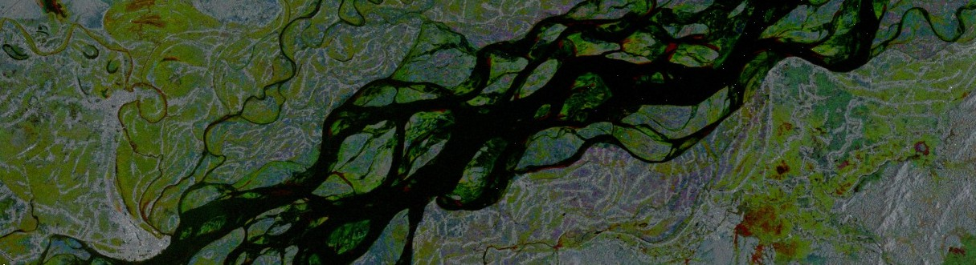
Visualization of SAR Imagery (Brahmaputra River)
VV Band
VH Band

Slide 12
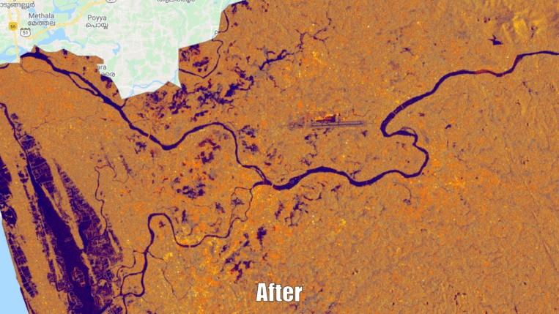
Our Goal Is To Be Able To Identify Like Such

Slide 13
Methodology
❖
Selecting pre and post flood event images, using ‘VH’ band for flood detection and applying speckle filter for noise reduction.
❖
Computing difference between images and applying a threshold for identifying changes.
❖
Using masks to remove permanent water bodies, isolated pixels, and steep terrain.
❖
Calculate the total flooded area.

Slide 14
Resources
❖
Detecting Changes in Sentinel-1 Imagery: Contributed tutorial in Earth Engine User Guide
❖
Visualisations were performed through google earth engine.

